Slide 1

First Presentation
BS Final Year Project
Optical Properties of Gain Incorporating Photonic Resonators
Ahmad Bilal
FA15-BPH-019
Supervisor: Dr. Ahmer Naweed

Slide 2
Idea of work
This theoretical research aims to explore distinctions between optical response of photonic resonators with or without gain based on finding of single gain incorporating resonator
Furthermore, this study aims to extend this research to multiple interacting resonators

Slide 3
Motivation
Usually optical resonators are lossy (intrinsic loss, scattering, coupling loss, etc.)
Resonators with gain may be used to overcome those losses.
Resonators with gain may have a great number of Application in Photonics and it as a fresh field of study.

Slide 4
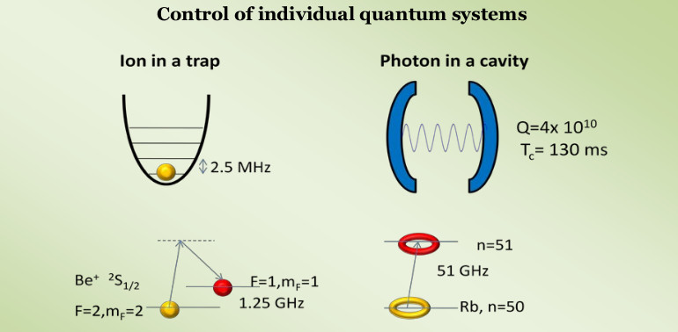
Motivation
The Nobel Prize in Physics 2012 was awarded jointly to Serge Haroche and David J. Wineland "for ground-breaking experimental methods that enable measuring and manipulation o=f individual quantum systems."

Slide 5
Plan of work
Study physics of passive optical resonators and
Investigate and comprehend the underlying physics of
gain incorporating photonic resonators.
Examine how the spectra of resonators with gain is
modified. (reproduce results)
Extend these ideas to arrays of coherently interacting
resonators and determine the effects of optical coupling.
Evaluate the feasibility of experimental implementation
of these findings.
Finalize the results of my FYP.

Slide 6
Expected Outcomes
It is anticipated that resonant optical features of active resonators as well as the underlying physics will be distinct from passive resonators.
Resonators with gain may enable control over resonator-wave guide coupling regimes and photon storage time in resonators.

Slide 7
Time Frame of Project (semester wise)
Semester 7 | Semester 8
Literature review and text book thoroughly to get the grasp on technical background | Research work and reproducing the results using different parameters
Learning different tools for modeling and reproducing the different calculation and data i-e Mathematica, Octave, python | Thesis writing and result compilation
Overall 50 to 60% work complete | Comparing the results and completing the work

